Slide 1
ETHICS AND LAWS FOR AI
Main reference: Ethics and Law in Data and Analytics, a course by Microsoft on edX

Slide 2
It will either be the best thing that’s ever happened to us, or it will be the worst thing. If we’re not careful, it very well may be the last thing.
-- Stephen Hawking

Slide 3
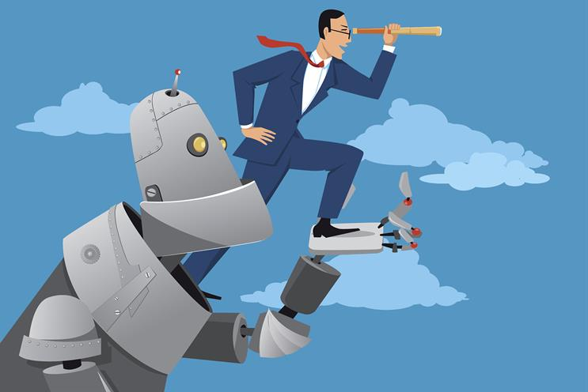
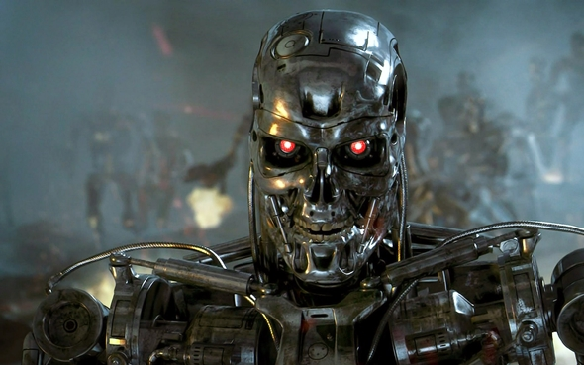






Images: campaignlive.co.uk, followingthenerd.com

Slide 4











Ethics
Three main approaches in normative ethics:
Virtue ethics:
Deontology:
Consequentialism:

Slide 5
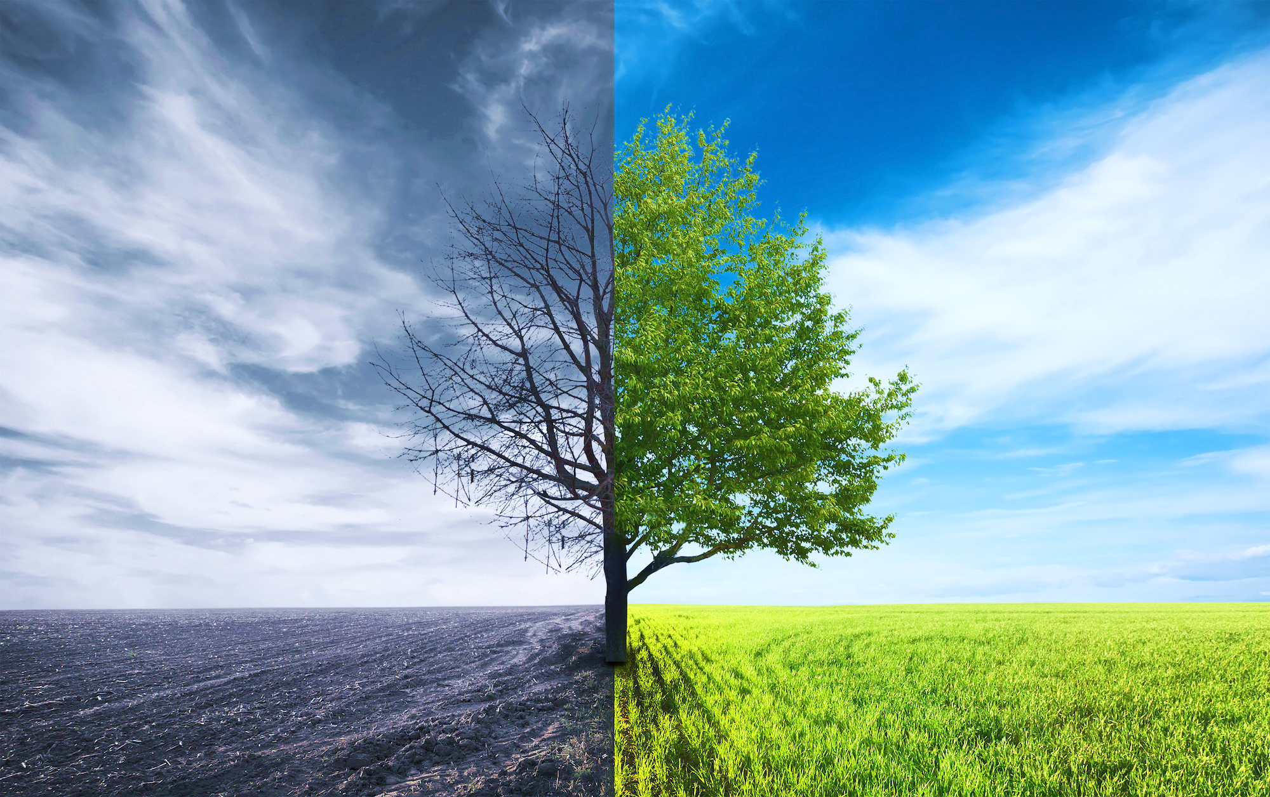













BAD
GOOD
Bad for others
Good for others
Killing
Stealing
Being lazy, drunk
Lying
Having an extramarital relationship
Saving lives
Helping others in need
Learning, working hard
Being honest
Being faithful
Photo credit: Tom Zeller Jr., undark.org
Notes:
Others: Người khác, môi trường, loài vật… (ngược đãi động vật cũng là bad)
Khác: là chữ “tha”, tức là cái gì ngoài mình ra.

Slide 6


“growing evidence suggests that volunteers reap health and well-being beneﬁts from their altruistic activities.”
– Dr Eric S. Kim, Harvard University
Data were from 12,998 participants in the Health and Retirement Study—a large, diverse, prospective, and nationally representative cohort of U.S. adults.
During the 4-year follow-up period, participants who volunteered ≥100 hours/year (versus 0 hours/year) had a reduced risk of mortality and physical functioning limitations, higher physical activity, and better psychosocial outcomes.
Source: Kim, E. S., Whillans, A. V., Lee, M. T., Chen, Y., & VanderWeele, T. J. (2020). Volunteering and subsequent health and well-being in older adults: an outcome-wide longitudinal approach. American Journal of Preventive Medicine.
Definition from Wikipedia: Volunteering is a voluntary act of an individual or group freely giving time and labour for community service.

Slide 7
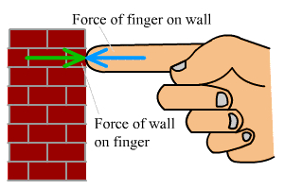
To every action there is always opposed an equal reaction.
– Newton's third law
Notes:
In physics: You and environment.

Slide 8

What goes around, comes around.

Slide 9
You reap what you sow. (English)
Du erntest, was du säst. (German)
On récolte ce que l'on sème. (French)
Lo que siembres, cosecharás. (Spanish)
กรรมใดใครก่อ กรรมนั้นย่อมสนอง. (Thai)
种瓜得瓜, 种豆得豆 (Chinese)
ທ່ານເກັບກ່ຽວສິ່ງທີ່ທ່ານປູກ. (Lao)
Gieo nhân nào, gặt quả nấy. (Vietnamese)

Slide 10
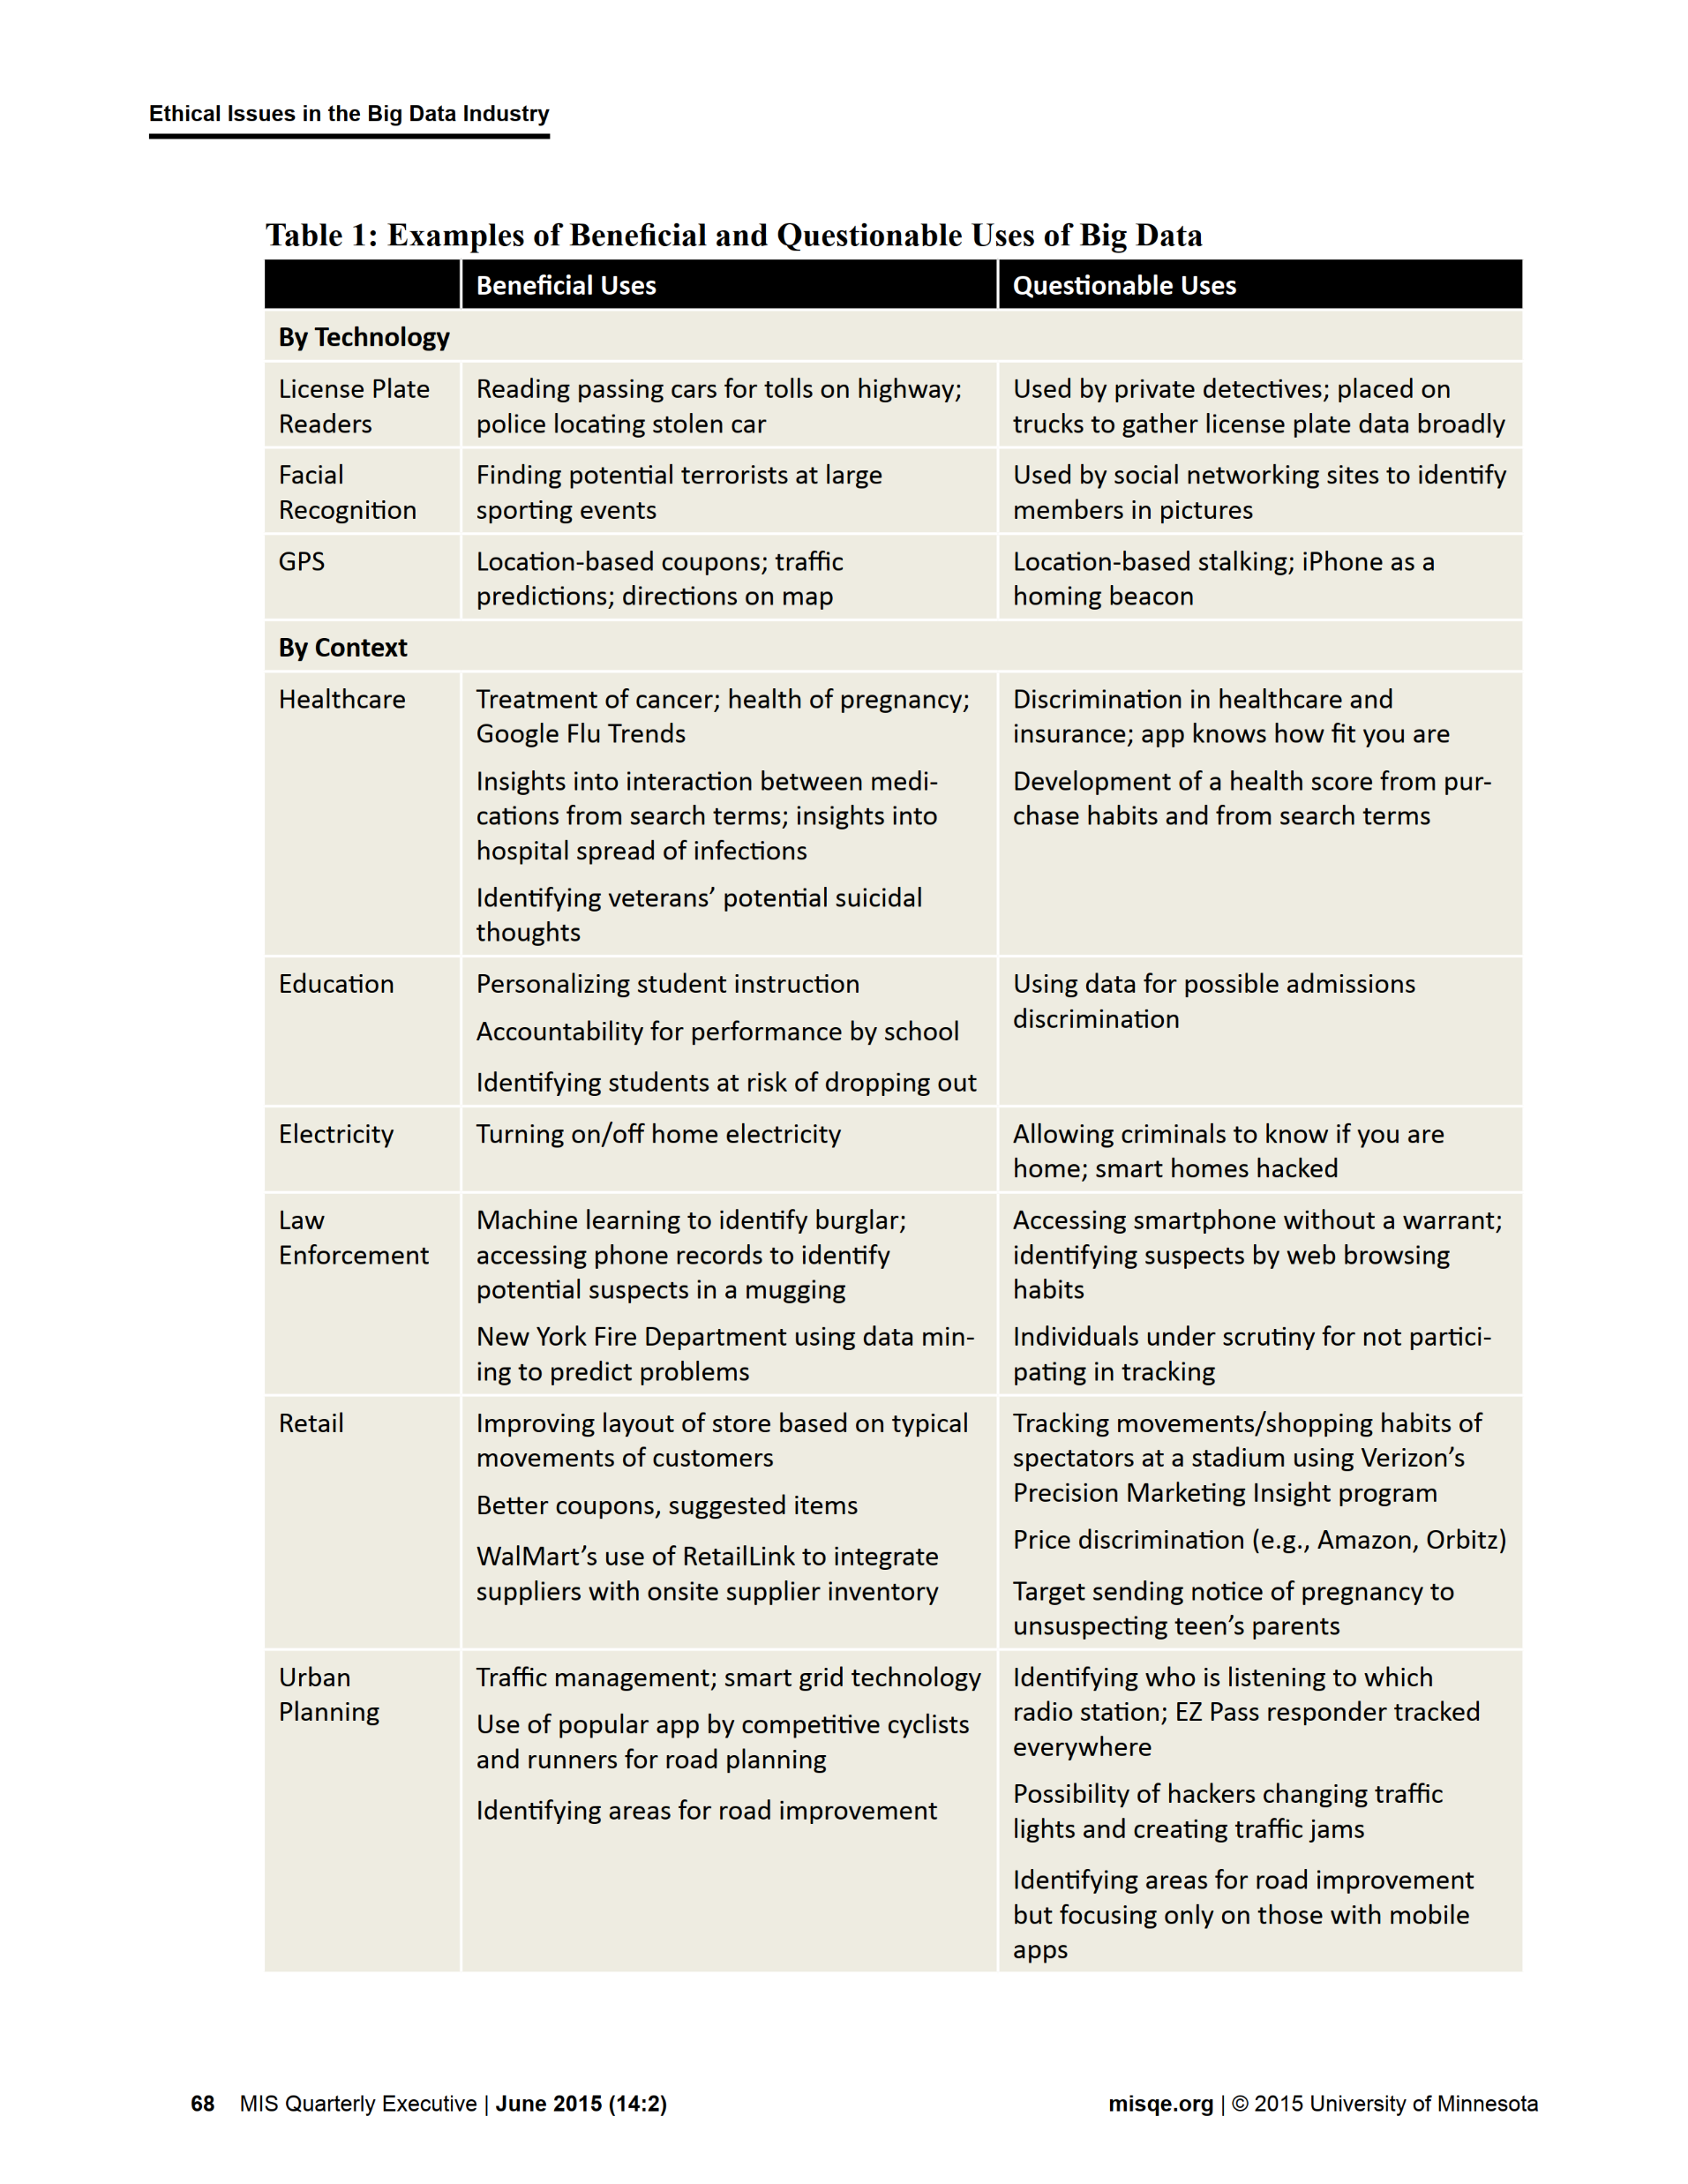

Source: Martin, K. E. (2015). Ethical issues in the big data industry. MIS Quarterly Executive, 14, 2.

Slide 11

Data analytics and Law
United States: privacy laws (e.g.,HIPAA 1996, COPPA 1998, FACTA 2003), Negligence laws
European Union: General Data Protection Regulation (GDPR), some main rules:
Data analytics must be fair.
You need permission to process data.
Individuals are allowed to access the personal data and correct if it's not correct.
Accountability.
…
Main reference: Ethics and Law in Data and Analytics, by Microsoft

Slide 12
IRAC
A traditional method for analyzing legal problems includes 4 parts: Issue, Rule, Application, and Conclusion (IRAC)
Issue: define the legal problem
Rule: identify laws that are applicable to the Issue
Apply: analyze the Issue according to the Rule
Conclusion: make legal conclusion to the Issue
Main reference: Ethics and Law in Data and Analytics, by Microsoft, edx.org/course/ethics-and-law-in-data-and-analytics-2

Slide 13

Example: U.S. Target marketing, 2012
Issue:
Rule:
Apply:
Conclusion:
Main reference: Ethics and Law in Data and Analytics, by Microsoft, edx.org/course/ethics-and-law-in-data-and-analytics-2

Slide 14




Whose fault: AI’s or human’s?
Example: Tesla Model S autopilot, 2016

Slide 15
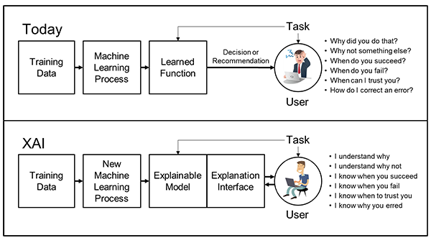






Explainable AI (XAI)
"New machine-learning systems will have the ability to explain their rationale, characterize their strengths and weaknesses, and convey an understanding of how they will behave in the future. […] These models will be combined with state-of-the-art human-computer interface techniques capable of translating models into understandable and useful explanation dialogues for the end user."
Source: DARPA, www.darpa.mil

Slide 16
Examples of XAI by
Microsoft: https://github.com/Microsoft/interpret
Google: https://cloud.google.com/explainable-ai

Slide 17
FUNDAMENTAL IDEAS AND CONCEPTS
Main reference:
Chapters 1 and 2 of Russell, S., & Norvig, P. (2016). Artificial intelligence: a modern approach.

Slide 18



















Four approaches to AI
Thinking humanly
Thinking rationally
Acting humanly
Acting rationally

Slide 19
Foundations of AI
To learn more: Section 1.2 of (Russell, 2016)

Slide 20














History of AI

Slide 21












Basic concepts

Slide 22
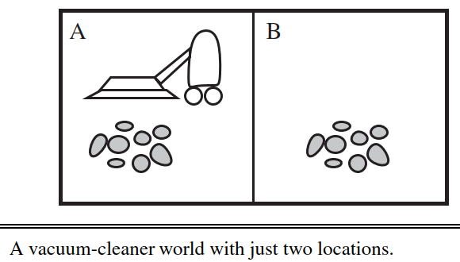

Example
Source: (Russell, 2016)

Slide 23






Design reward systems
Reward system for the vacuum-cleaner world

Slide 24
Example 2: design reward system for chess playing agent.
System 1: +1 for a win, 0 for a draw, -1 for a lose
System 2: +1 for capturing an opponent's piece, -1 for being captured a piece
Exercise: design reward system for maze escape agent.

Slide 25





A GENERAL RULE:

